Slide 1
P Versus NP Problems

Slide 2
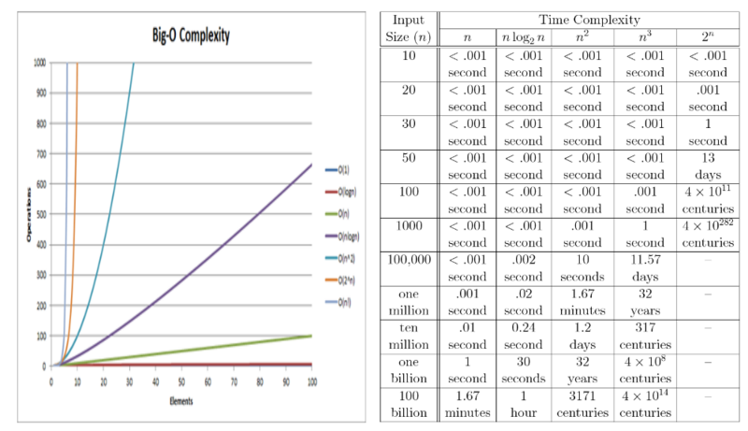

Slide 3
Polynomial time
Linear Searching
Binary Searching
Insertion sort
Bubble sort
Merge sort
Exponential time
0/1 knapsack
TSP
Sum of subsets
Need a faster Algorithm…..
NP hard and NP Complete are guidelines made for doing research on exponential time problems

Slide 4
Points to consider if you are unable to solve exponential time algorithm using polynomial time
If not able to write deterministic algms, write non- deterministic algms
Try to find a relationship between exponential algorithms so that if one is solved in polynomial time, others are also solved in polynomial time
In Deterministic algorithms, we know the working of the algorithmic.

Slide 5
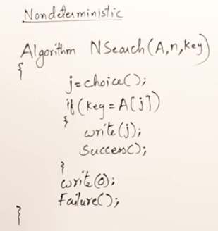
Non- Deterministic Algorithm
Don’t know how they will work
Most of the statements are deterministic
Few are non-deterministic----preserved for future use

Slide 6
We define 2 classes here
P
NP

Slide 7
Need a base problem
Satisfiability problem

Slide 8
Exponential time
0/1 knapsack
TSP
Sum of subsets

Slide 10
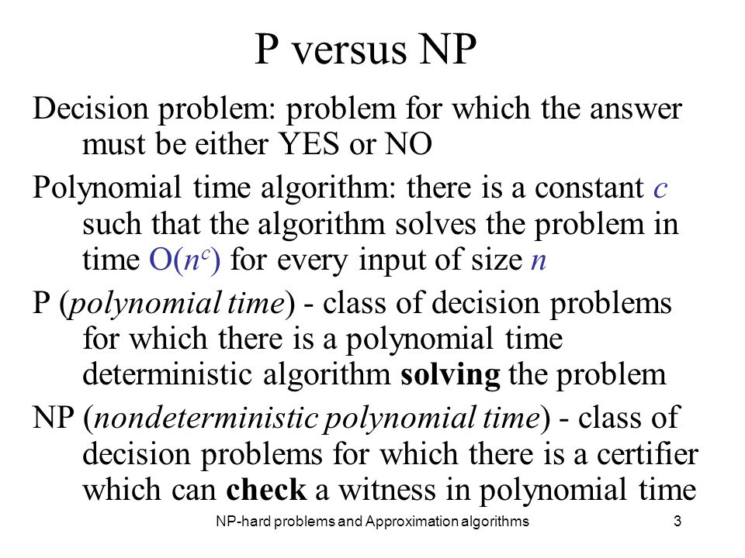

Slide 11
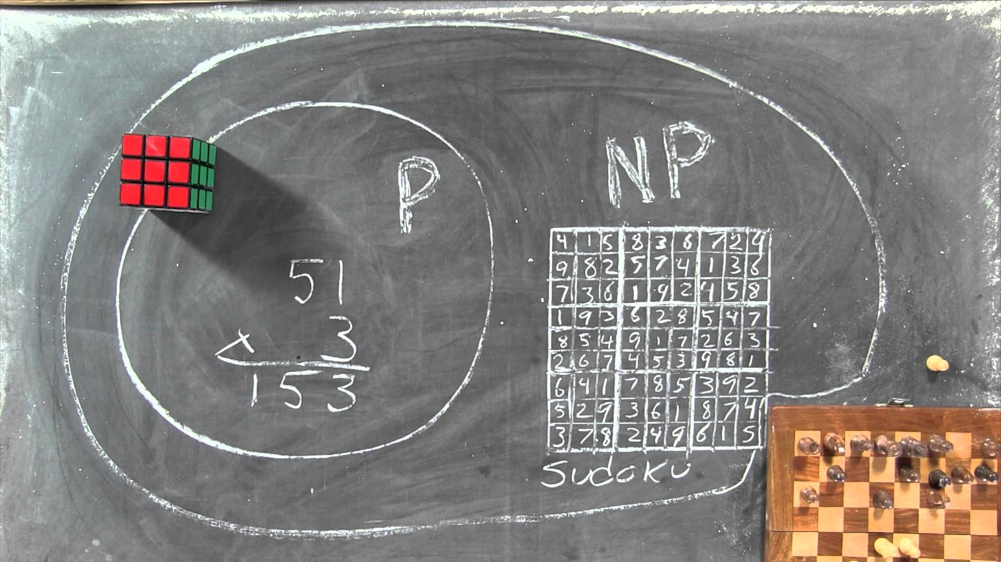

Slide 12
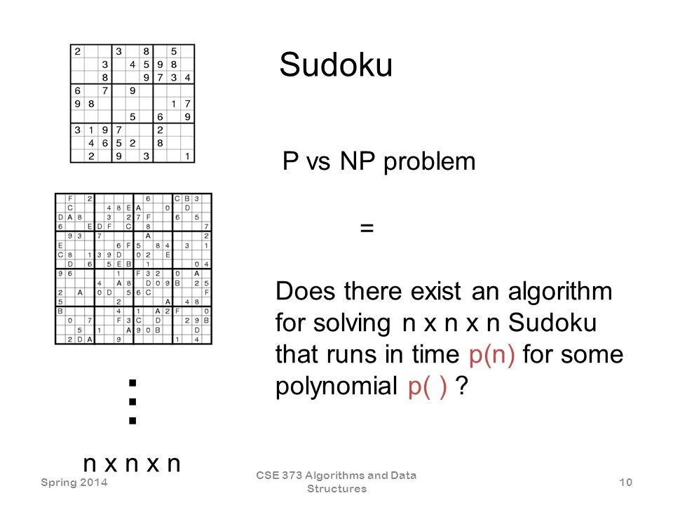

Slide 13
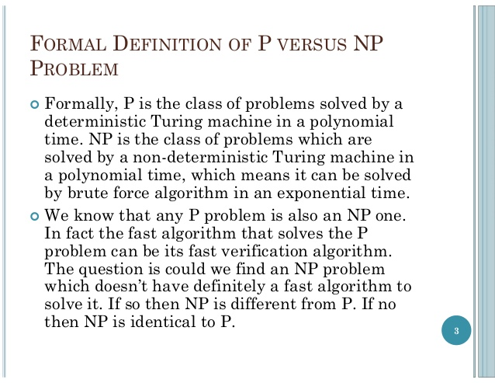

Slide 14
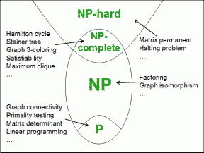

Slide 15
NP-Complete & NP-Hard

Slide 16
What’s P and NP?
P = { problems solvable in polynomial time}
NP = { decision problems solvable in non-deterministic polynomial time}
- can be varified in polynomial time.
Is P=NP ?

Slide 17
NP-COMPLETE
problems whose status is unknown.
hardest problems in NP set.
No polynomial time algorithm has yet been discovered for any NP complete problem.
If any one of the NP complete problems can be solved in polynomial time, then all of them can be solved.
If two problems can be reduced to each-other, they are in some sense, "equivalent". All problems in NP that are so equivalent, are called NP-Complete.

Slide 18
How can we say that a problem is NP complete?
2 conditions-
X E NP
X is NP hard

Slide 19
NP-HARD
The precise definition here is that a problem X is NP-hard, if there is an NP-complete problem Y, such that Y is reducible to X in polynomial time.
these are the problems that are at least as hard as the NP-complete problems.
I can reduce Problem B to Problem A if, given a solution to Problem A, I can easily construct a solution to Problem B.

Slide 20
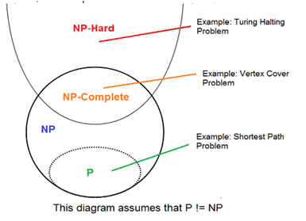

Slide 21
But since any NP-complete problem can be reduced to any other NP-complete problem in polynomial time, all NP-complete problems can be reduced to any NP-hard problem in polynomial time. Then, if there is a solution to one NP-hard problem in polynomial time, there is a solution to all NP problems in polynomial time.
NP-complete problems are either optimization, search or decision problems.The classical TSP is an optimization problem. For a problem to be striclty NP-hard it should be neither an optimization/decision/search problem

Slide 22
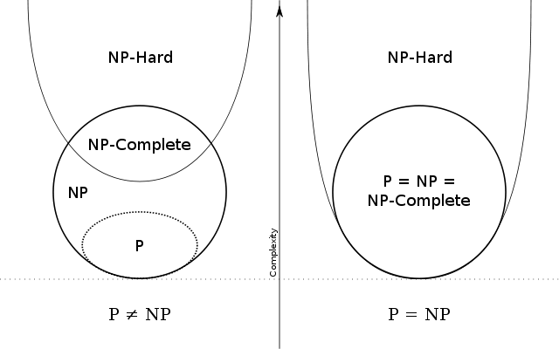

Slide 23
NP-completeness and reducibility

Slide 24
NP-completeness
NP-complete problems are the hardest problems in NP set. A decision problem L is NP-complete if: 1) L is in NP (Any given solution for NP-complete problems can be verified quickly, but there is no efficient known solution). 2) Every problem in NP is reducible to L in polynomial time

Slide 25
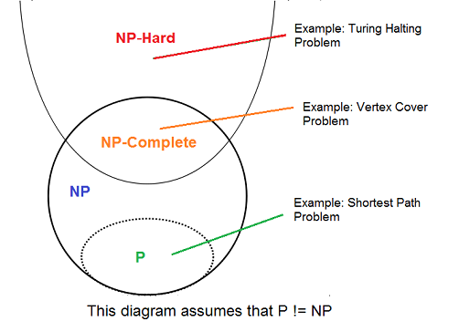

Slide 26
NP-completeness and Reducibility
A (class of) problem P₁ is poly-time reducible to P₂ , written as P₁ ≤_{p} P₂ if there exists a poly-time function
f: P₁ → P₂ such that for any instance of p₁∈ P₁, p₁ has “YES” answer if and only if answer to f(p₁) (∈ P₂) is also “YES”.

